Slide 1


Janani G

Slide 2

Outline
01
Executive Summary
04
Results
02
Introduction
05
Conclusion
03
Methodology
06
Appendix

Slide 3

Executive Summary
1
2
3
4
5
6
Collection data from API and web page
Data Wrangling: transforming and mapping data
Exploratory data EDA by analysis (EDA) visualization by using SQL
Predictive analysis by
machine learning
Interactive visual analytics and dashboards
Summary: Select the best model for future prediction.
4

Slide 4







Introduction
SpaceX’s goal:
Sending spacecraft to the International Space Station.
Starlink, a satellite internet constellation providing satellite Internet access.
Sending manned missions to Space.
Object
Spaces X’s Falcon 9 launch
Goal
To determine the price of each launch.
Reason
If we can determine if the first stage will land, we can determine the cost of a launch
Method
By gathering information about Space X and creating dashboards:
To determine if SpaceX will reuse the first stage
Train a machine learning model and use public information to predict if SpaceX will reuse the first stage
5

Slide 5

Section 1
6

Slide 6
Methodology
Data collection methodology:
  Require the data from SpaceX API
  Collect data from a Wikipedia page
Perform data wrangling
  Perform EDA to find some patterns
  Determine what would be the label for training supervised model
Perform exploratory data analysis (EDA) using visualization and SQL
Perform interactive visual analytics using Folium and Plotly Dash
Perform predictive analysis using classification models
  Compare logistic regression model, support vector machine tree decision classifier, KNN by using
GridSearchCV to select the best fit model
7

Slide 7
Data Collection
1
API
2
Web page
spacex_url="https://api.spacexdata.com/v4/ launches/past"
https://en.wikipedia.org/wiki/List_of_Falcon\_9
\_and_Falcon_Heavy_launches
Required the data from Space API
Clean the data
Extract a Falcon 9 launch records HTML table from Wikipedia
Parse the table and convert it into a Pandas data frame

Slide 8

Data Collection – SpaceX API
Request data from SpaceX API
Convert the json result into a dataframe
Filter dataframe to only Falcon 9` launches and data wrangling
Export to csv
Link :
https://github.com/Jananijana2712/SpaceX-Falcon_9_First_Stage_Landing_Prediction/blob/main/1.1%20SpaceX%20the%20Data%20Collection%20API%20Lab.ipynb
A
Request data
B
Convert into dataframe
C
Data wrangling
D
Save to csv file

Slide 9
A
Data Collection – Scraping
Request the Falcon9 Launch Wiki page from its URL
Extract all column/variable names from the HTML table header
Create a data frame by parsing the launch HTML tables
Export to csv
Link :
https://github.com/Jananijana2712/SpaceX-Falcon_9_First_Stage_Landing_Prediction/blob/main/1.2%20SpaceX%20the%20Data%20Collection%20with%20Web%20Scraping%20lab.ipynb
Request data
B
Extract data
C
Parse data
D
Save to csv file

Slide 10
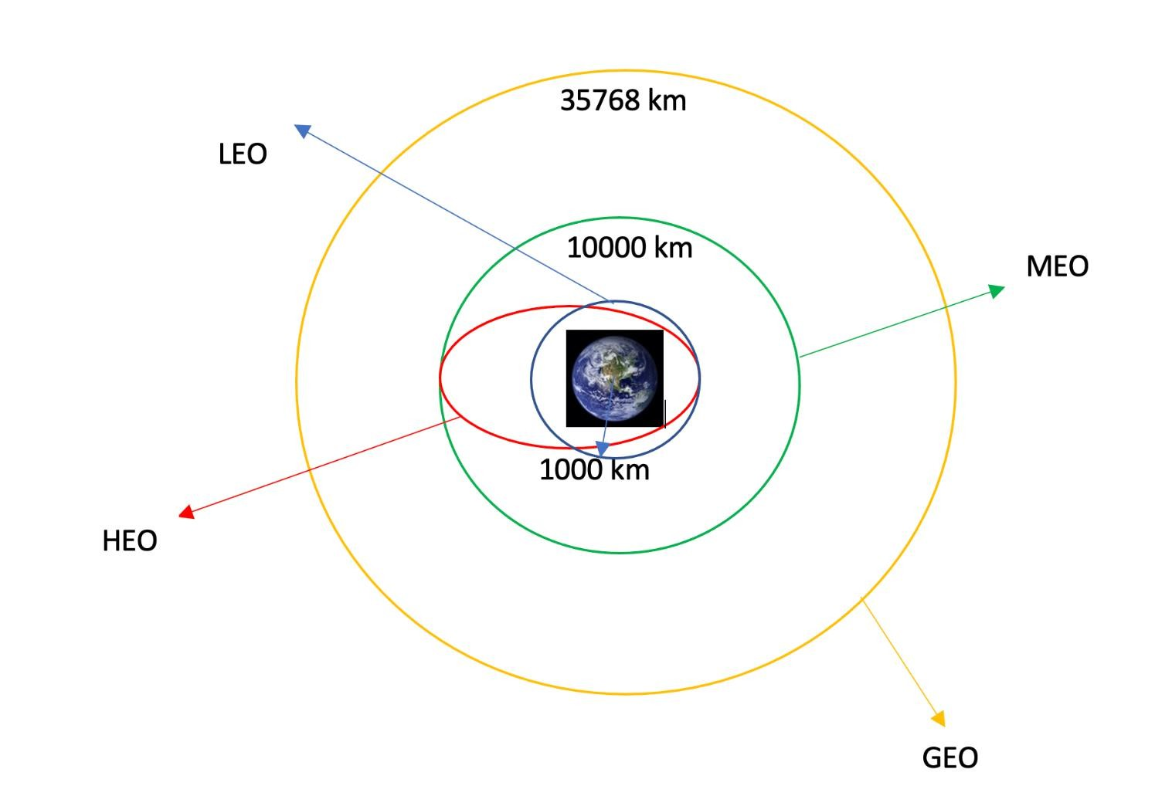
Data Wrangling
Specify the missing value
Calculate the number of launches on each site
Calculate the number and occurrence of each orbit
Calculate the number and occurrence of each orbit
Create a landing outcome label from Outcome column
Link: https://github.com/Jananijana2712/SpaceX-Falcon_9_First_Stage_Landing_Prediction/blob/main/1.3%20SpaceX%20Data%20Wrangling.ipynb

Slide 11

EDA with Data Visualization
The relationship between Flight Number and Launch Site -> scatter plot
The relationship between Payload and Launch Site -> scatter plot
The relationship between success rate of each orbit type -> bar plot
The relationship between Flight Number and Orbit type -> scatter plot
The relationship between Payload and Orbit type -> scatter plot
The launch success yearly trend -> line chart
The scatter plot is the best to describle the relation between two categorical data
The bar plot is the best to compare several categorical data
The line plot is the best to show the time series data
https://github.com/Jananijana2712/SpaceX-Falcon_9_First_Stage_Landing_Prediction/blob/main/1.4%20SpaceX%20%20the%20EDA%20with%20Visualization.ipynb

Slide 12
EDA with SQL
Display the names of the unique launch sites in the space mission
Display 5 records where launch sites begin with the string 'CCA’
Display the total payload mass carried by boosters launched by NASA (CRS)
Display average payload mass carried by booster version F9 v1.1
List the date when the first successful landing outcome in ground pad was achieved.
List the names of the boosters which have success in drone ship and have payload mass greater than 4000 but less than 6000
List the total number of successful and failure mission outcomes
List the names of the booster_versions which have carried the maximum payload mass.
List the records which will display the month names, failure landing_outcomes in drone ship ,booster versions, launch_site for the months in year 2015.
Rank the count of successful landing_outcomes between the date 04-06-2010 and 20-03-2017 in descending
order.
https://github.com/Jananijana2712/SpaceX-Falcon_9_First_Stage_Landing_Prediction/blob/main/Assignment%20SQL%20Notebook%20for%20Peer%20Assignment.ipynb

Slide 13


Build an Interactive Map with Folium
Mark all launch sites on a map
Mark the success/failed launches for each site on the map
Calculate the distances between a launch site to its proximities
  Whether it is close to the coast
  Whether it is close to the railway
  Whether it is close to the highway
  Whether it is close to the city
To find some geographical patterns about launch sites
https://github.com/Jananijana2712/SpaceX-Falcon_9_First_Stage_Landing_Prediction/blob/main/1.5%20SpaceX%20Interactive%20Visual%20Analytics%20with%20Folium.ipynb

Slide 14
Build a Dashboard with Plotly Dash
A launch site drop-down input component
A success-pie-chart based on the selected site dropdown
A range slicer to select payload
A success-payload-scatter-chart scatter plot based on the selected site dropdown
To inspect the relationship of success rate between lauch site and payload
https://github.com/Jananijana2712/SpaceX-Falcon_9_First_Stage_Landing_Prediction/blob/main/spacex%20dash%20app.py

Slide 15


Predictive Analysis (Classification)
1
2
3
4
Data wrangling
Data standarization
Split into traning and test datasets
Predictive model evalutation
Logistic regression
Support vector machine
Decision tree classifer
K-nearest neighnors
Predictive model selection
K-nearest neighnors
https://github.com/Jananijana2712/SpaceX-Falcon_9_First_Stage_Landing_Prediction/blob/main/1.6%20SpaceX%20Machine%20Learning%20Prediction.ipynb

Slide 16
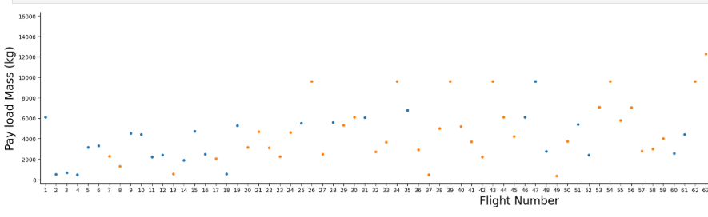
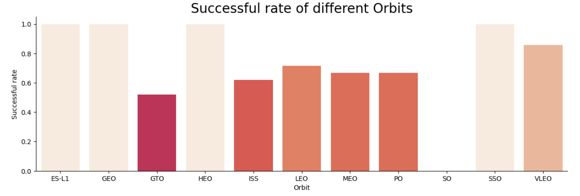
Results
EDA
KSC LC-39A and VAFB SLC
4E has a success rate of 77%
VAFB SLC 4E has no payload above 10000 kg
In the LEO orbit the Success appears related to the number of flights
With heavy payloads the successful landing or positive landing rate are more for Polar,LEO and ISS
The sucess rate since 2013 kept increasing till 2020
Interactive analytics
Predictive analysis
According to the decision tree classifier model, the predictive model tells us that there will be 4 ture postive, 7 true negative, 5 false postive and 2 false negative . The accuracy of the mode is around 89% with the best parameters.

Slide 17

Section 2

Slide 18
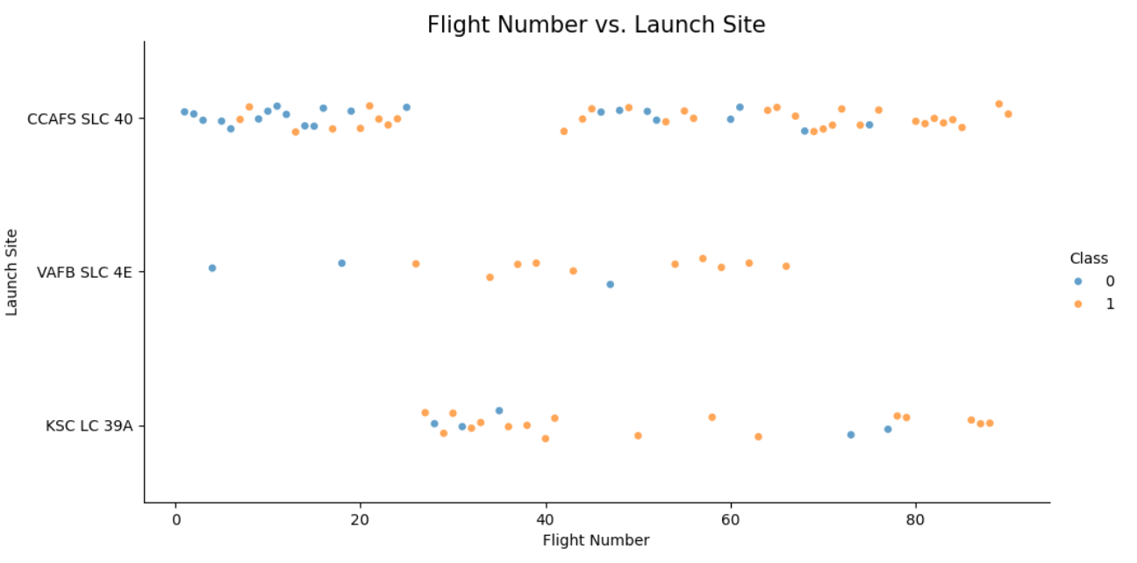
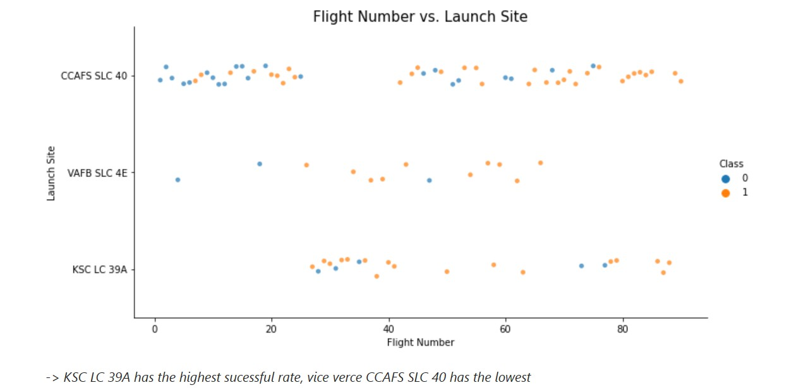
Flight Number vs. Launch Site

Slide 19
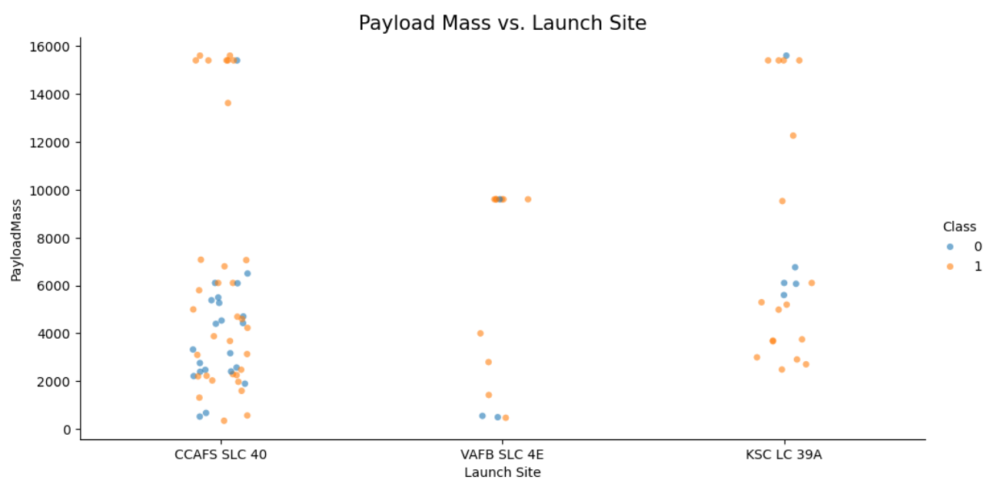
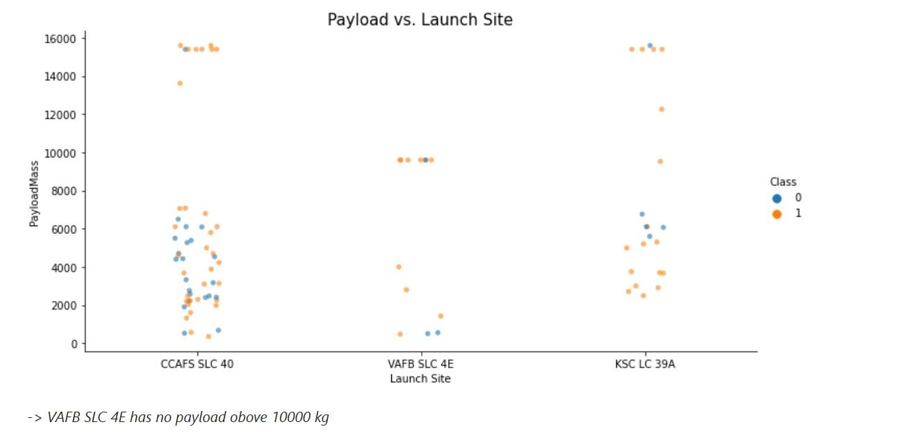
Payload vs. Launch Site

Slide 20
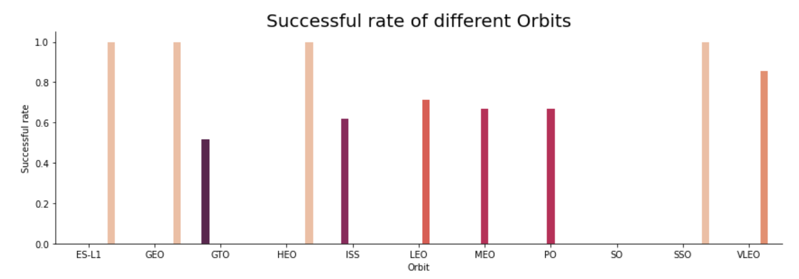
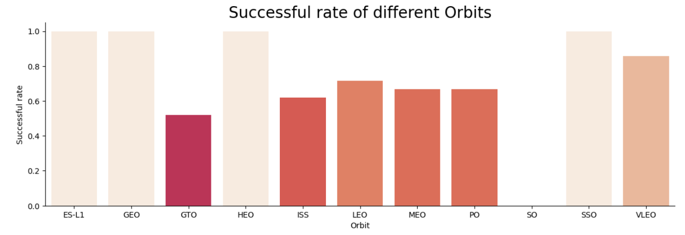
Success Rate vs. Orbit Type
-> ES – L1, GEO, HEO, SSO have the highest success rate

Slide 21
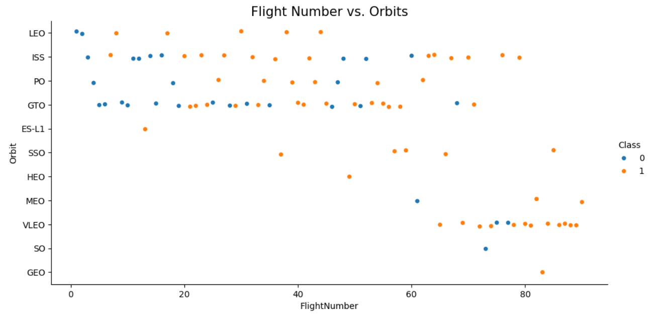
Flight Number vs. Orbit Type

Slide 22
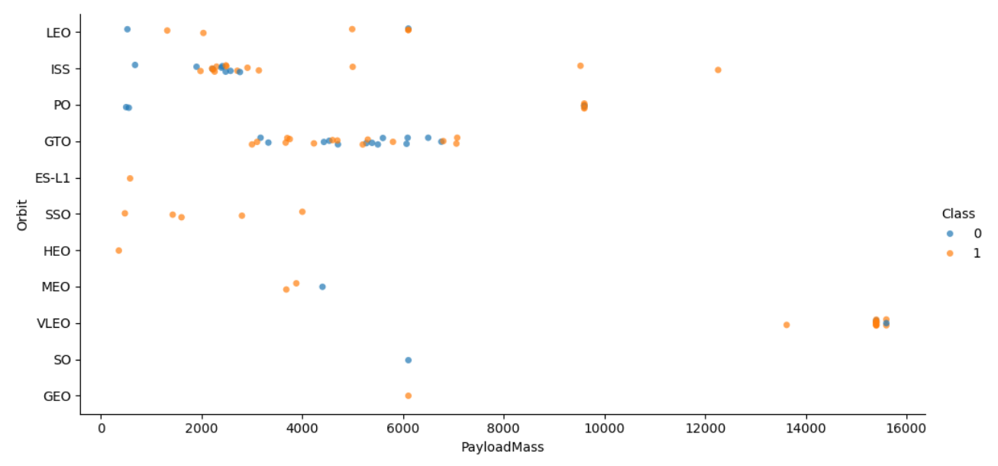
Payload vs. Orbit Type

Slide 23
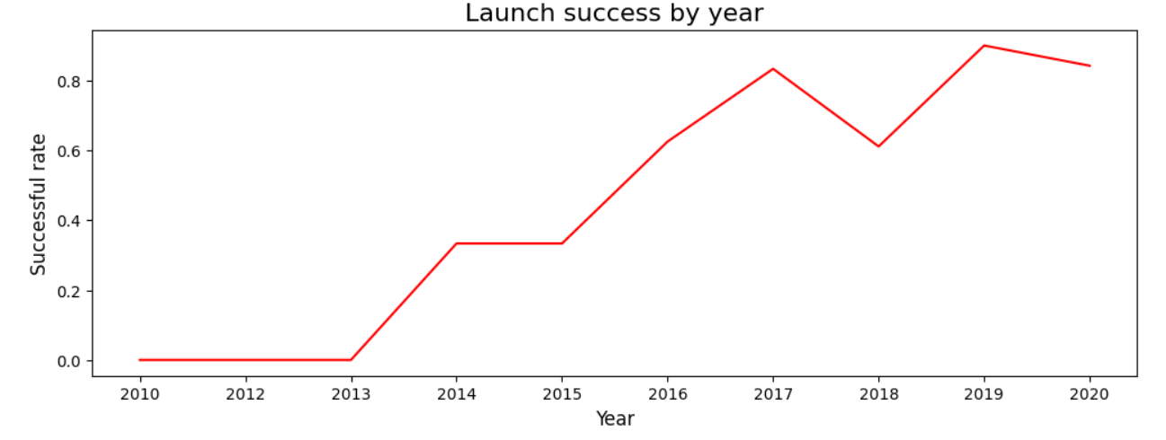
Launch Success Yearly Trend

Slide 24
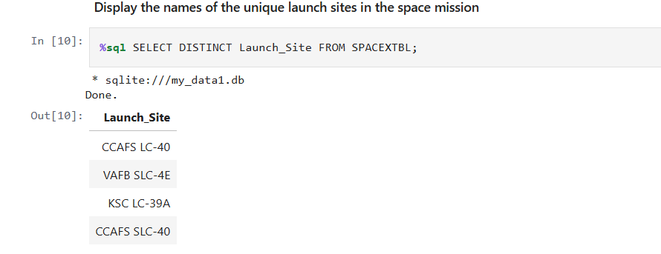
All Launch Site Names

Slide 25
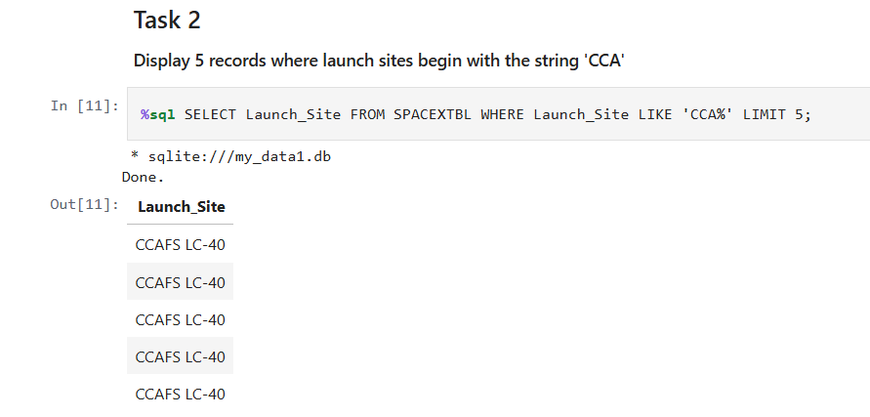
Launch Site Names Begin with 'CCA'

Slide 26
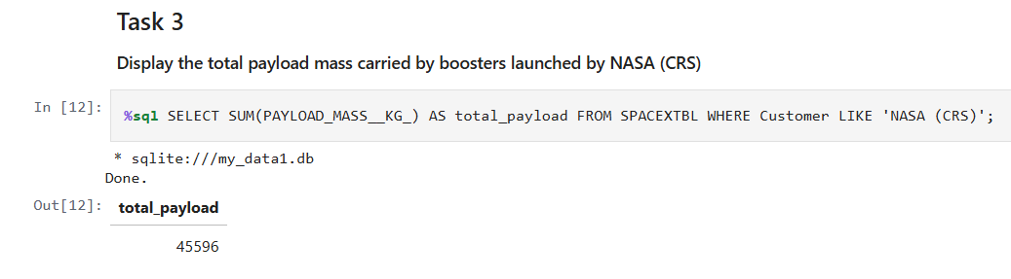
Total Payload Mass

Slide 27
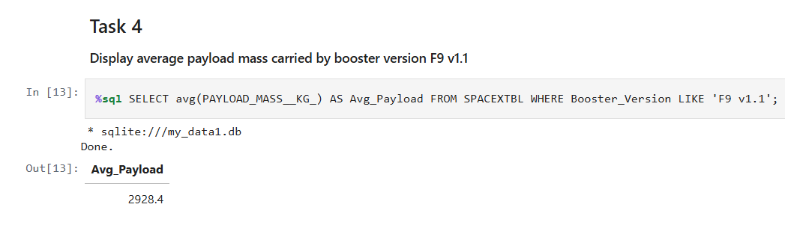
Average Payload Mass by F9 v1.1
-> The average payload mass carried by booster version F9 v1.1 is 2,928.40 kg

Slide 28
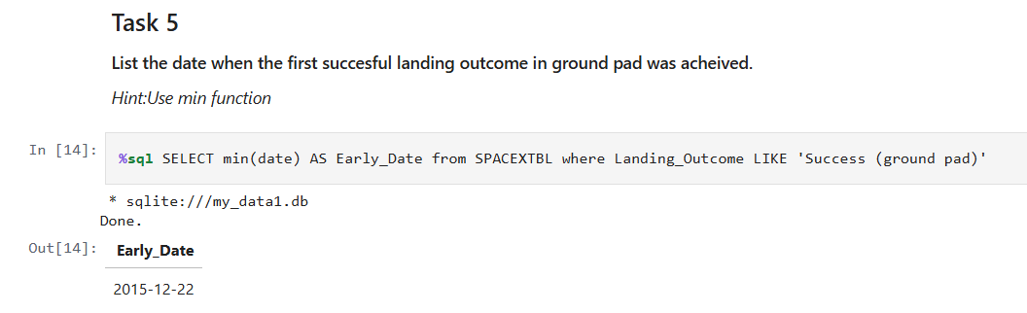
First Successful Ground Landing Date
-> The first ground landing successful is on 01.05.2017

Slide 29
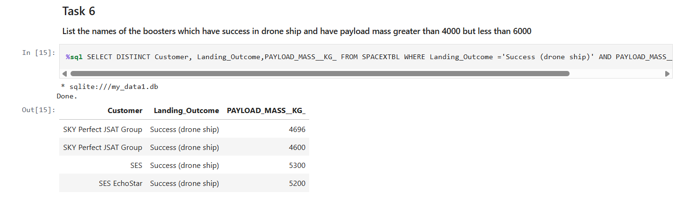
Successful Drone Ship Landing with Payload between 4000 and 6000
-> The most successful landing is by drone ship.

Slide 30
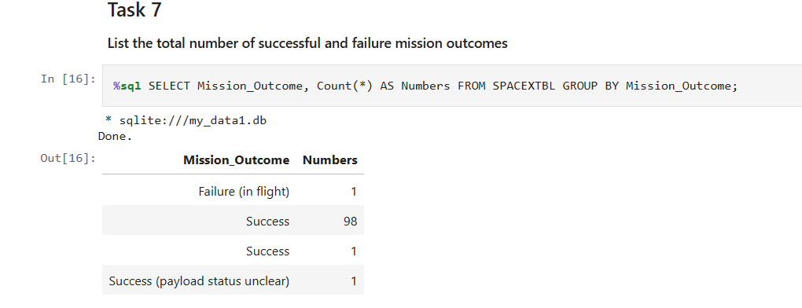
Total Number of Successful and Failure Mission Outcomes

Slide 31
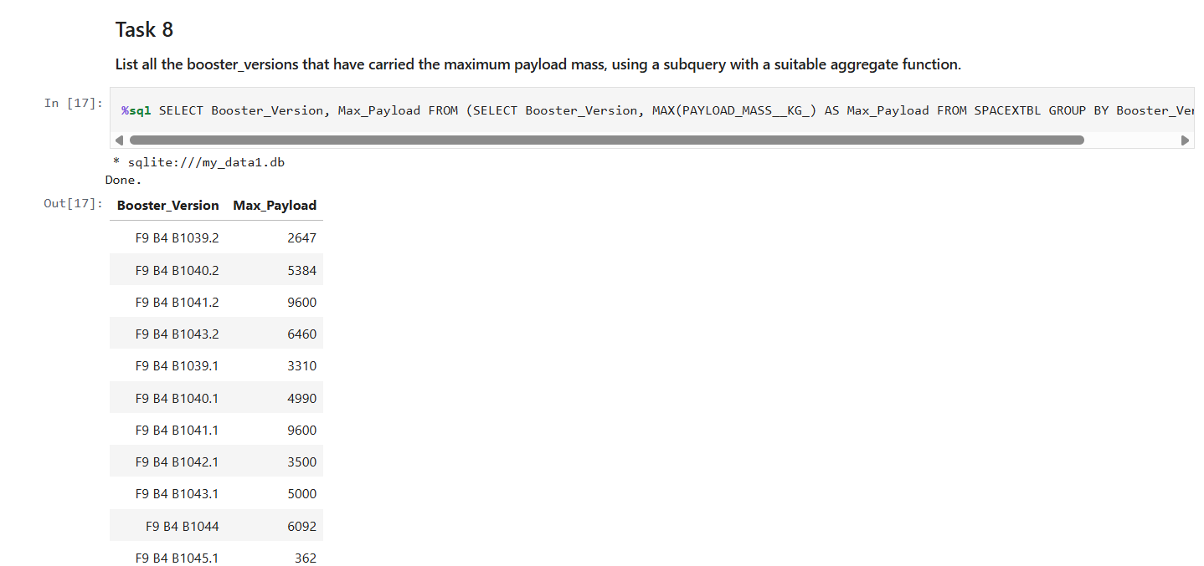
Boosters Carried Maximum Payload
-> Different booster version has different max payload mass.

Slide 32
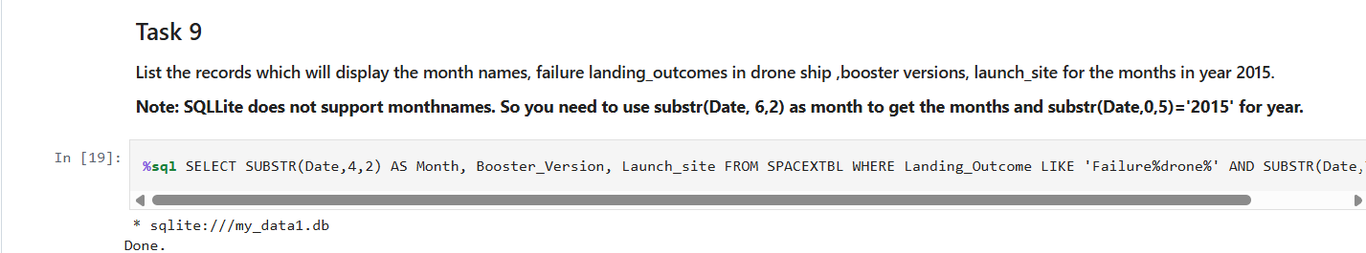
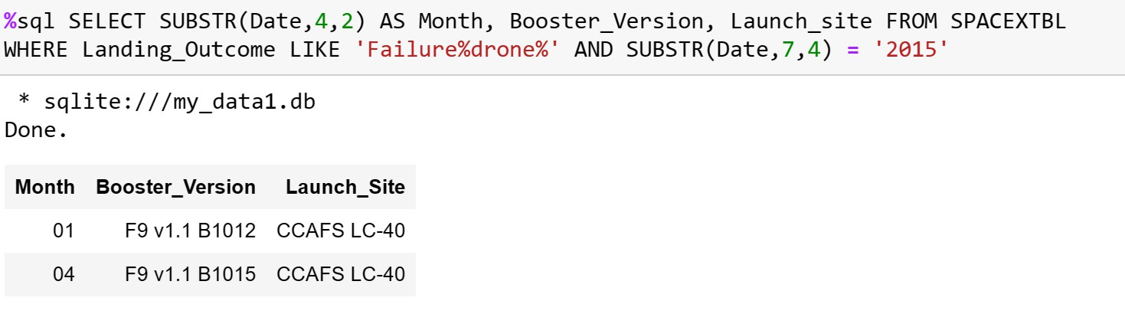
2015 Launch Records

Slide 33
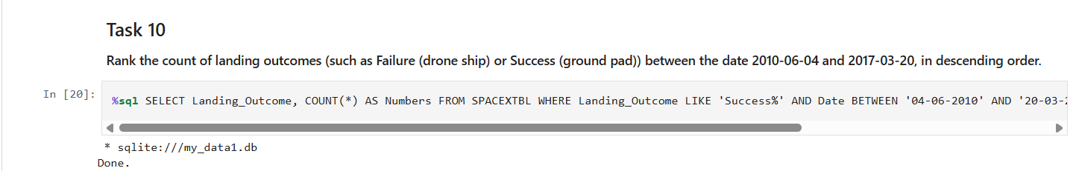
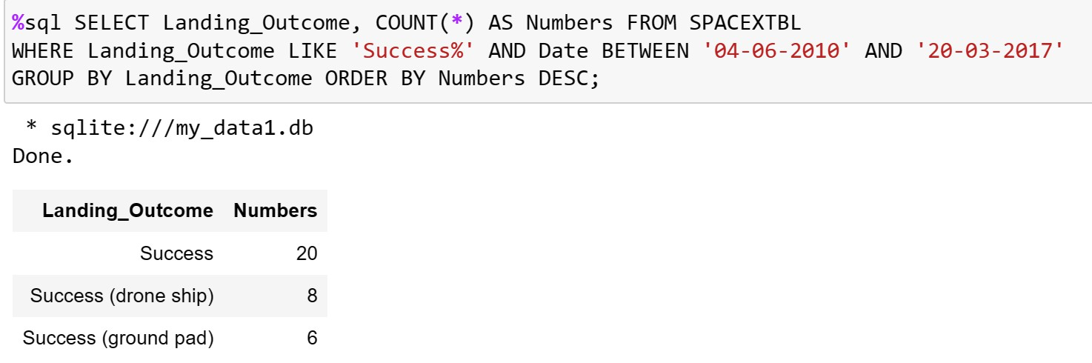
Rank Landing Outcomes Between 2010-06-04 and 2017-03-20

Slide 34

Section 3

Slide 35
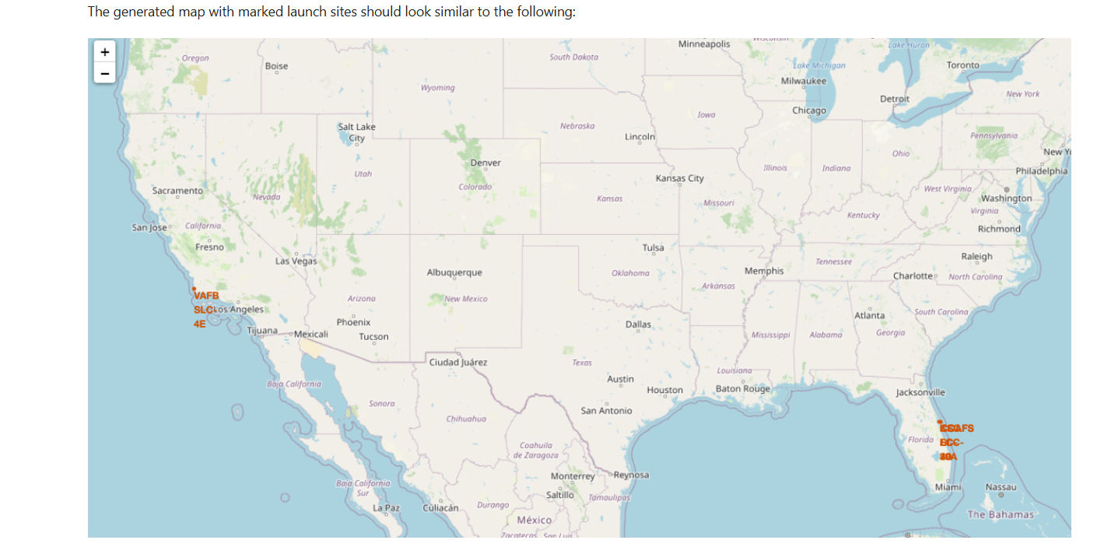
<All launch sites>

Slide 36
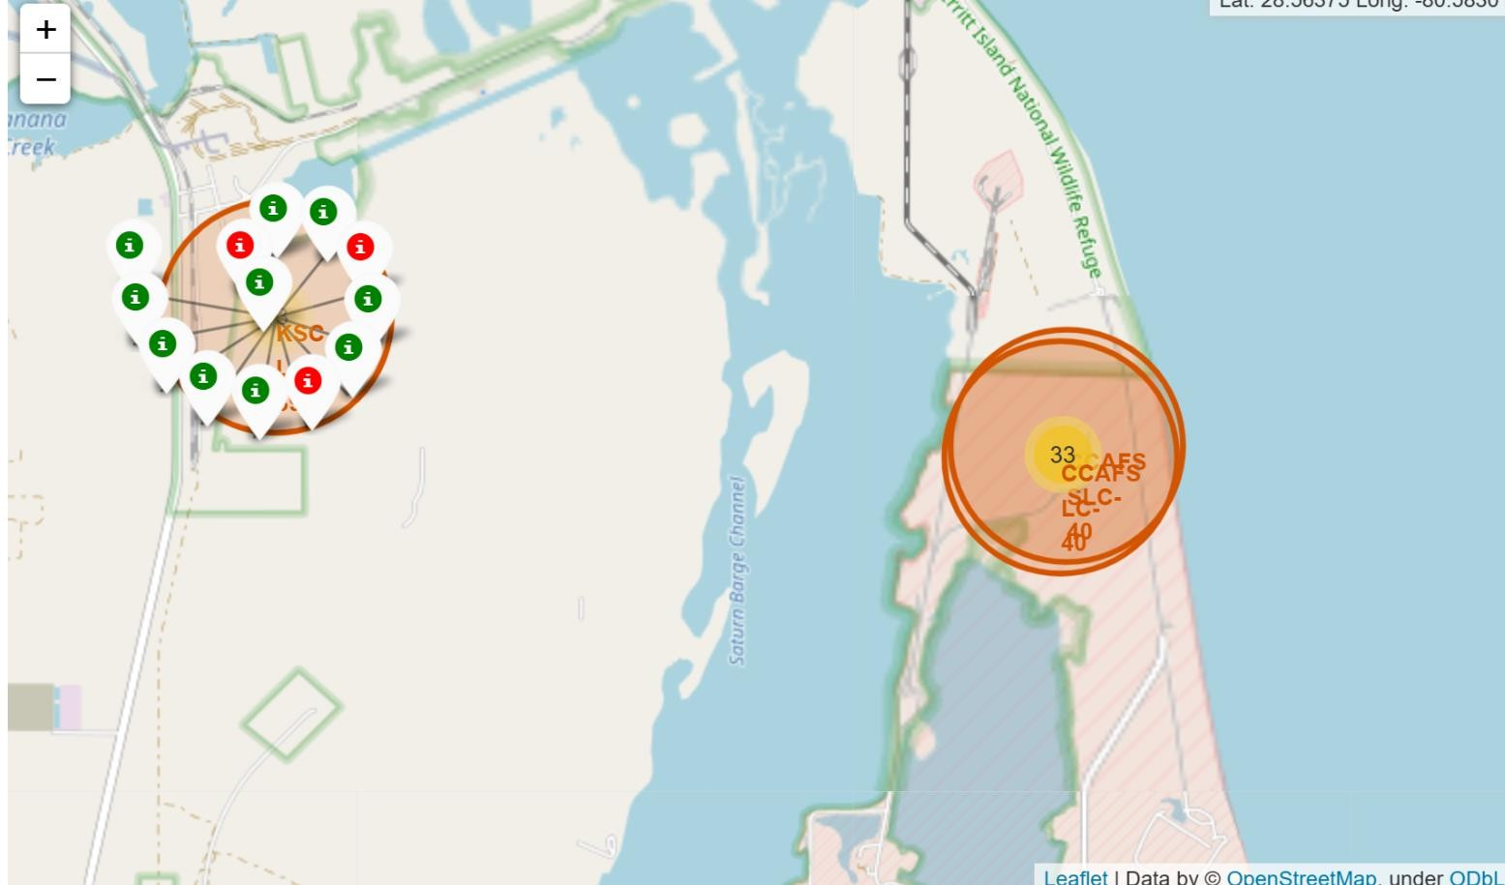
Launch outcome of different site

Slide 37
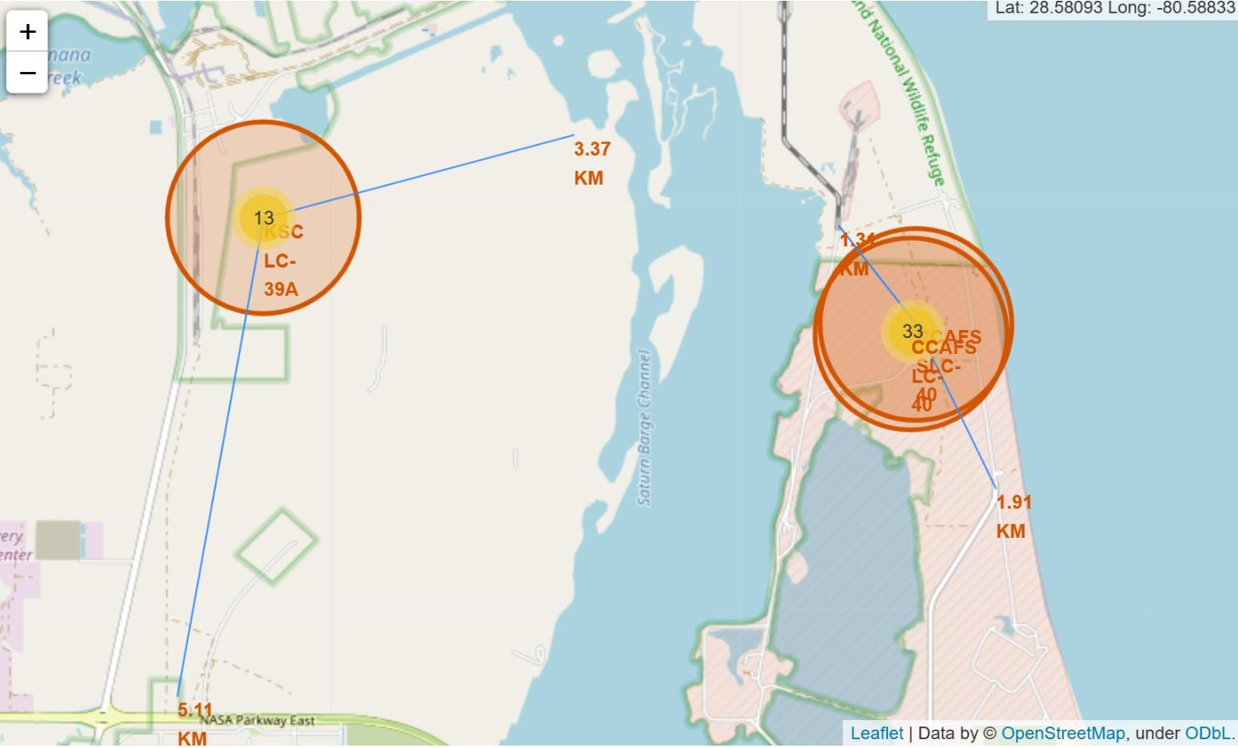
The proximity of the launch sites

Slide 38

Section 4

Slide 39
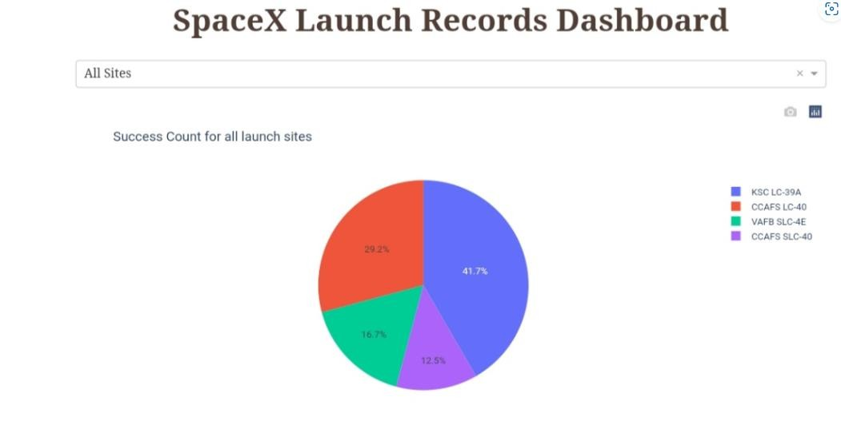
All site launch

Slide 40
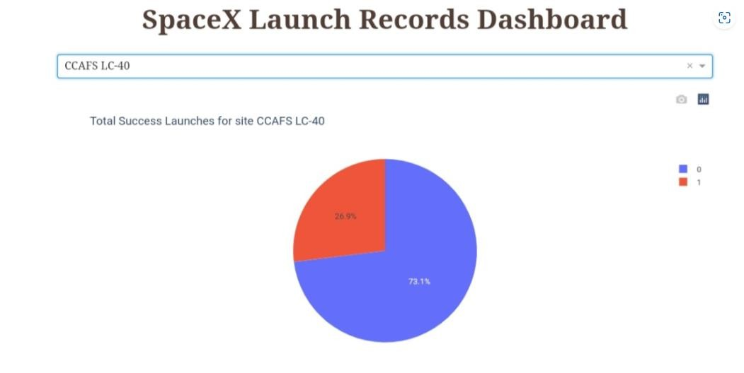
Highest success launch ratio

Slide 41

Section 5

Slide 42
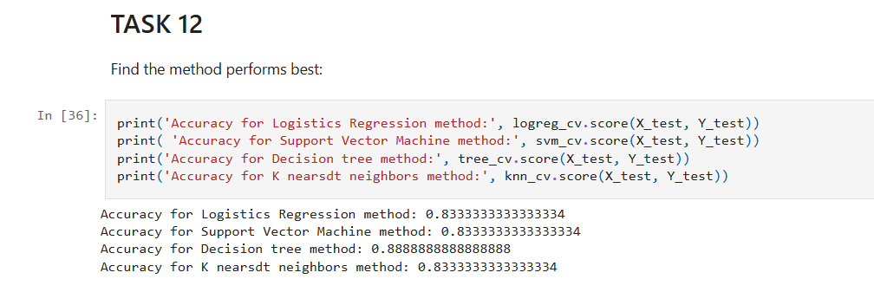
Classification Accuracy

Slide 43
Conclusions
There is a correlation between launch site and success rate Payload mass is also associated with the success rate.: the more massive the payload, the less likely the first stage will return
For orbit type, SO has the least success rate while ES-L1, GEO, HEO and SSO have the highest success rate According to the yearly trend
There has been an increase in the success rate since 2013 kept increasing till 2020
With best parameter provided, decision tree classifier used in prediction yielded the highest accuracy of 89%. .

Slide 44
Appendix
https://github.com/Jananijana2712/SpaceX-Falcon_9_First_Stage_Landing_Prediction
https://www.coursera.org/learn/applied-data-science-capstone/home/welcome

Slide 45


